Slide 1
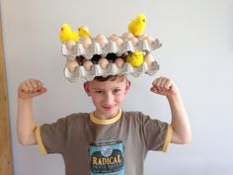
My Home Learning Journey. Some Extra Ideas for Easter!
Special Task
Phonics/Literacy
Could you write an Easter card to your family using your Phonic knowledge? Remember to:
-Sound out each word using your ‘Robot arms’
-Use a phonics sound mat or phonics flashcards if you are unsure of the sounds
-Remember your finger spaces, capital letters and full stops.
Maths
Ask a grown up to write the numbers 1-20 on egg shapes and hide them for you to find. Can you recognise all the numbers? Can you order the eggs? Or you could have a typical egg hunt where you count how many eggs you have found.
Can you use your recycling/bits from around the house to make an Easter bonnet? OR Could you decorate a hard boiled egg? You could send us a photo on EExat!
Let’s get Physical!
Set up an obstacle course outside for your family. You could time how long it takes them to complete it. Maybe they could even Bunny Hop their way round it! Or if you have enough eggs you could have an egg and spoon race.
Learn a nursery rhyme and add some moves to go alongside it.
Can you sequence the Easter Story with the pictures in your pack?

